Slide 1
Why vaccinate ?
After clean water, vaccination is the most effective public health intervention in the world for saving lives, promoting good health and preventing serious illness
Protects the individual
Vaccines teach your immune system how to create antibodies that protect you from diseases.
It's much safer for your immune system to learn this through vaccination than by catching the diseases and treating them.
Once your immune system knows how to fight a disease, it can often give you lifelong protection.
Protects the community and stops spread of disease
Having a vaccine also benefits your whole community through "herd immunity".
If enough people are vaccinated, it's harder for the disease to spread to those people who cannot have vaccines. For example, people who are ill or have a weakened immune system

Slide 2
Vaccinations offered by BCHC …
School Based programme (clinic offer also available)
Seasonal flu – school aged children ( this academic year from reception to year 11) Parental choice for IM vaccine due to porcine gelatine content available in clinics – call 0121 466 3410 to book.
Teenage booster vaccination – routinely given in year 9 , opportunistic to older pupils if missed in year 9 .Can also be accessed at the GP.
HPV ( Human papilloma virus) – routinely given in year 8.Older pupils who have missed the vaccination can access via our service or the GP.
MMR – offered to pupils in yr. 8 & 9 who do not have 2 MMR vaccines recorded on CHIS.
Domiciliary vaccination offer
Neo-natal hepatitis B vaccination- to all babies born to mothers who test +ve for Hepatitis B during maternal screening.
Community Clinic offer
Neo-natal BCG vaccination- to all babies identified as high risk of BCG .Under aged of 12 months BCHC provide vaccination, over 12 months the TB service.

Slide 3
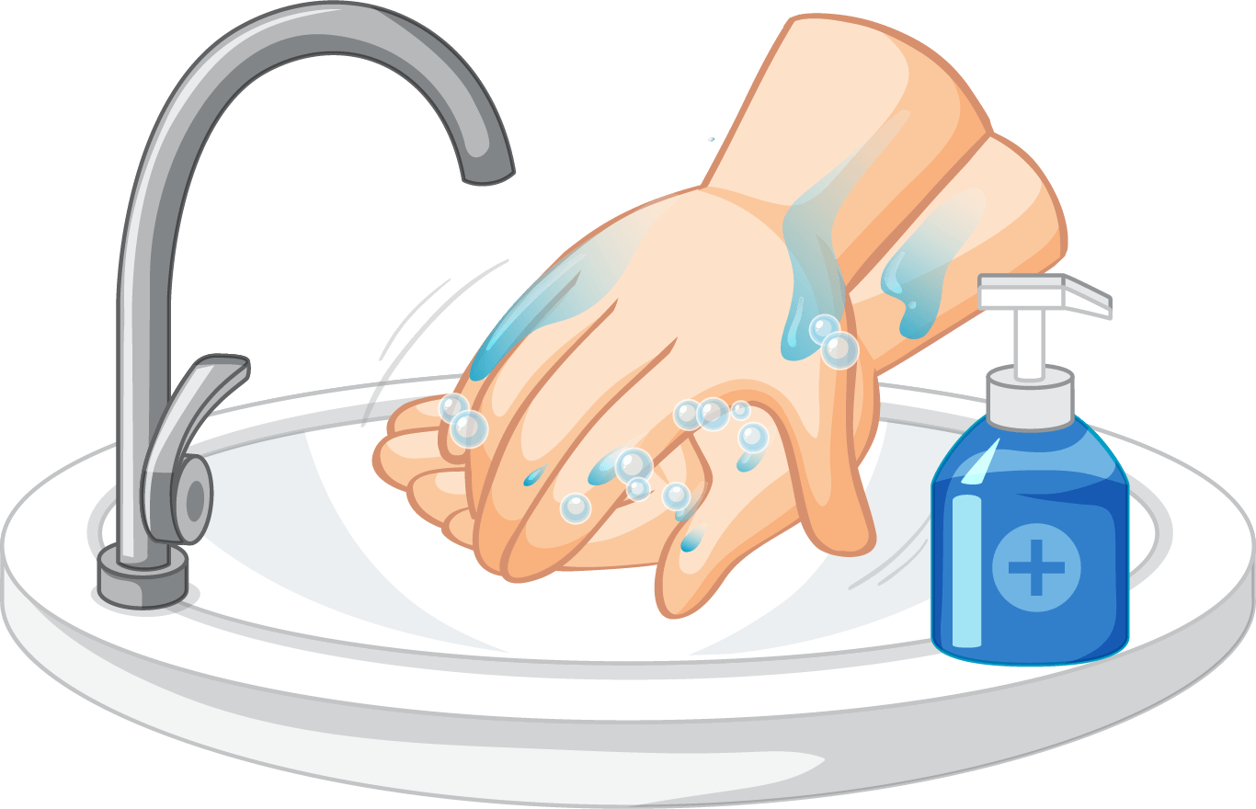


How To Prevent Flu?
Wash your hands often with warm water and soap.
Cover your mouth and nose with a tissue when you cough or sneeze.
Put used tissues in the bin.
Get your flu vaccine!
This year the flu spray is also offered at both primary & secondary school (between September and December )

Slide 4
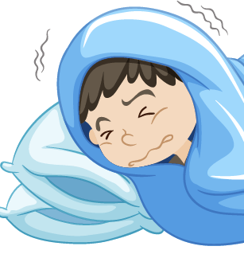
Seasonal Flu… symptoms
High temperature
An aching body
Feeling very tired
A dry cough
A sore throat
Headache
Difficulty sleeping
Loss of appetite
Feeling and/or being sick
Tummy pain
Prevent these – get your flu vaccination

